Slide 1
Solitude Temp & Rainfall

Slide 2
2023
2022
2021

Slide 3
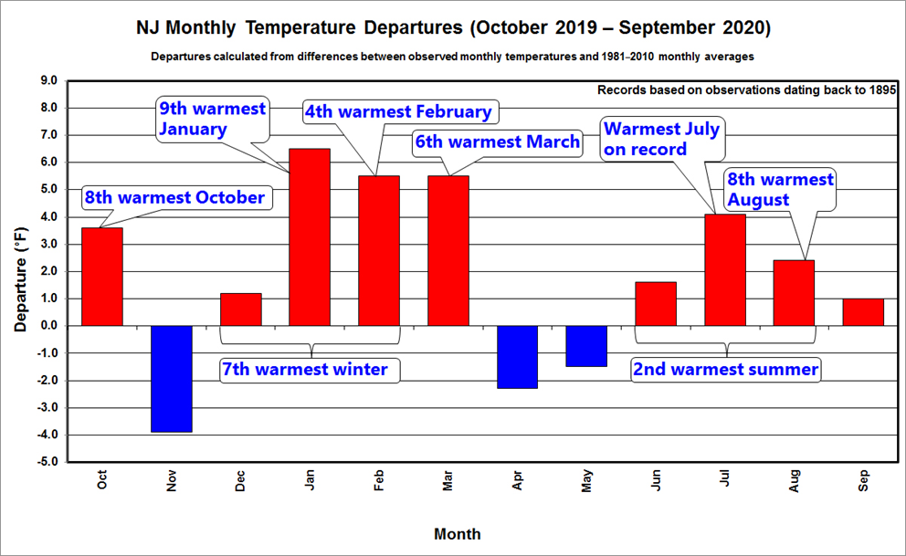
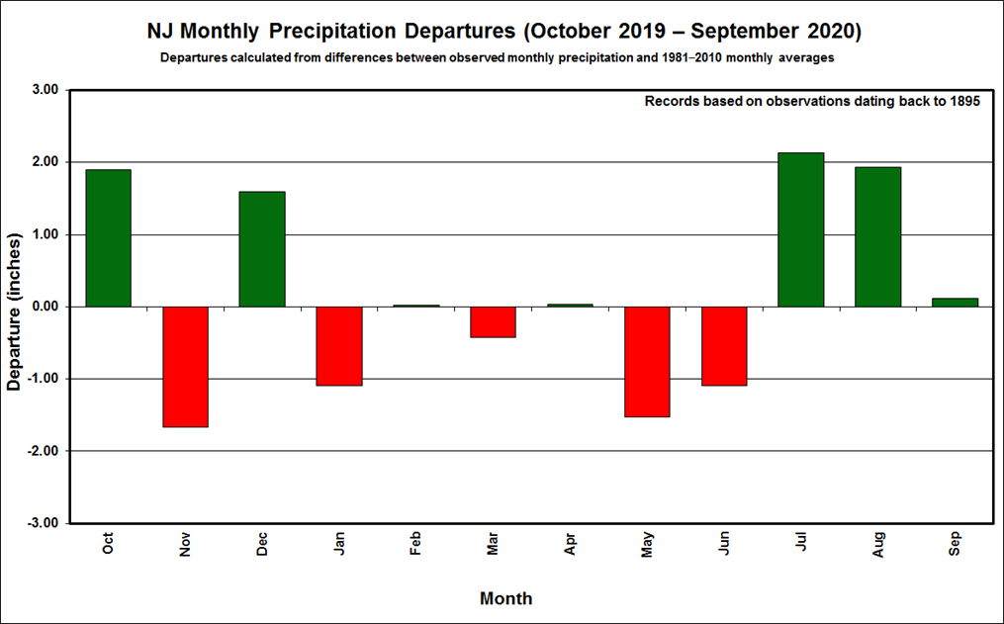
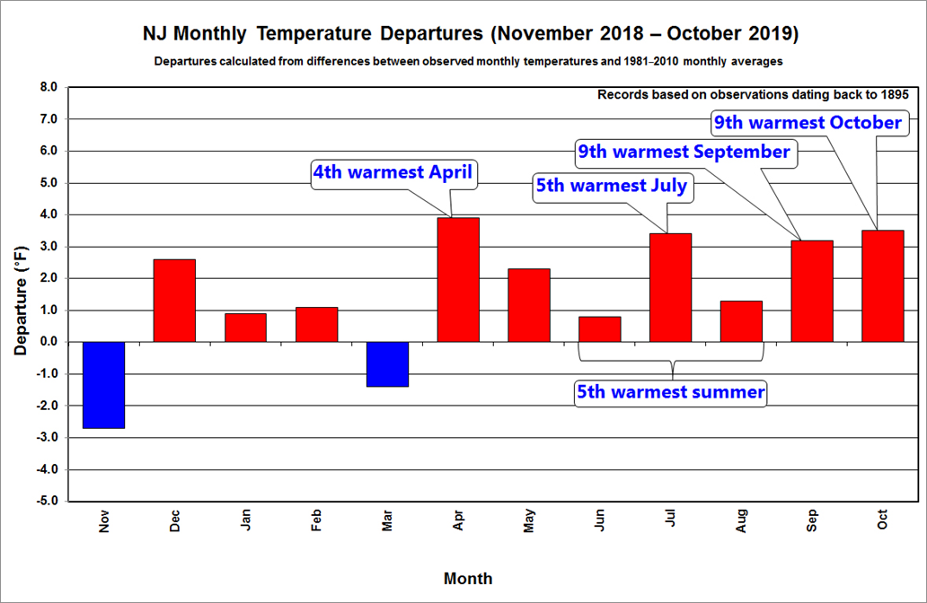
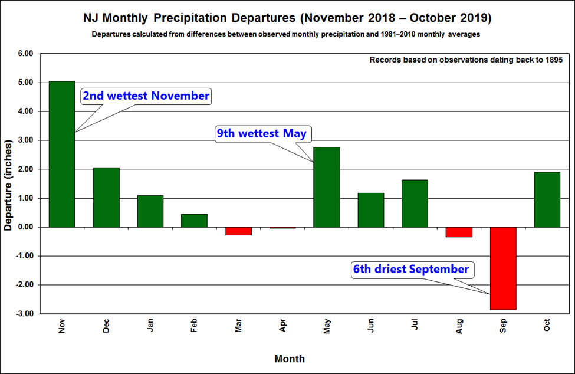
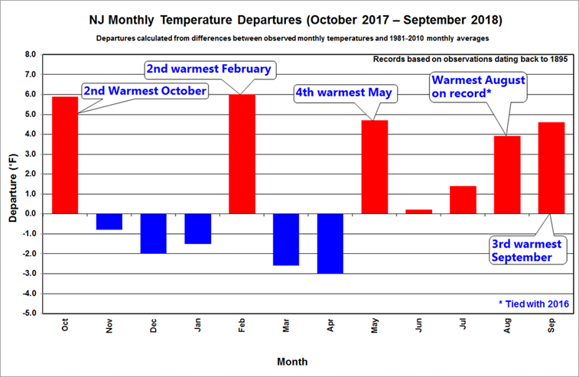
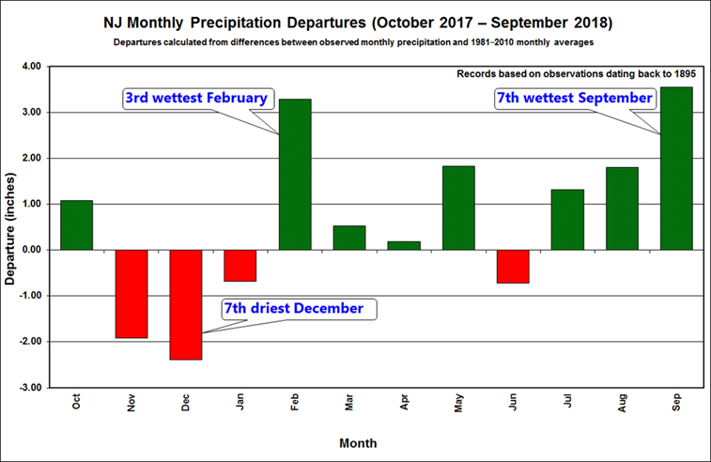
2020
2019
2018

Slide 4
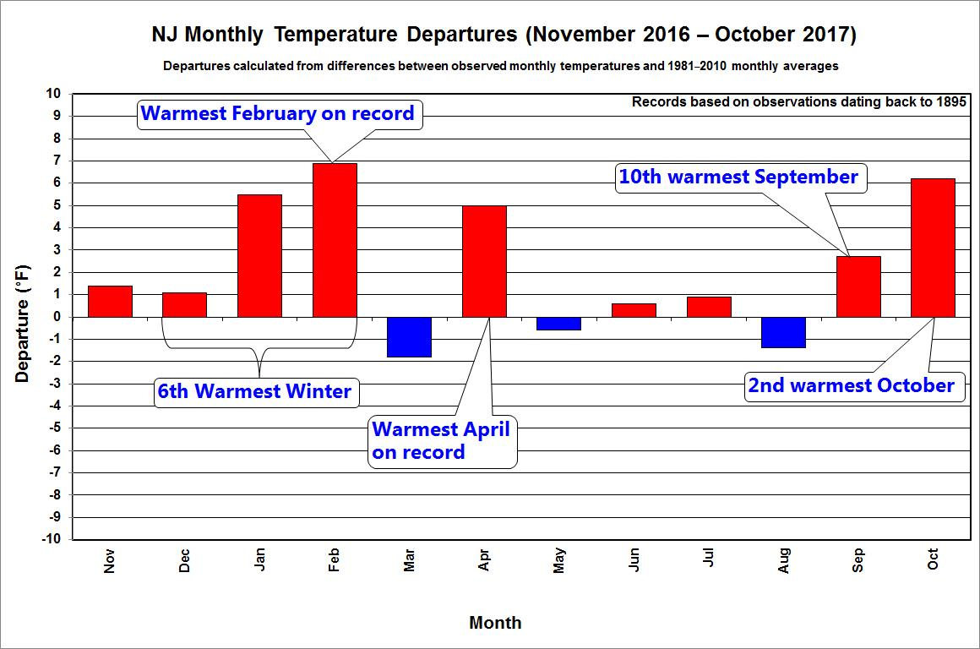
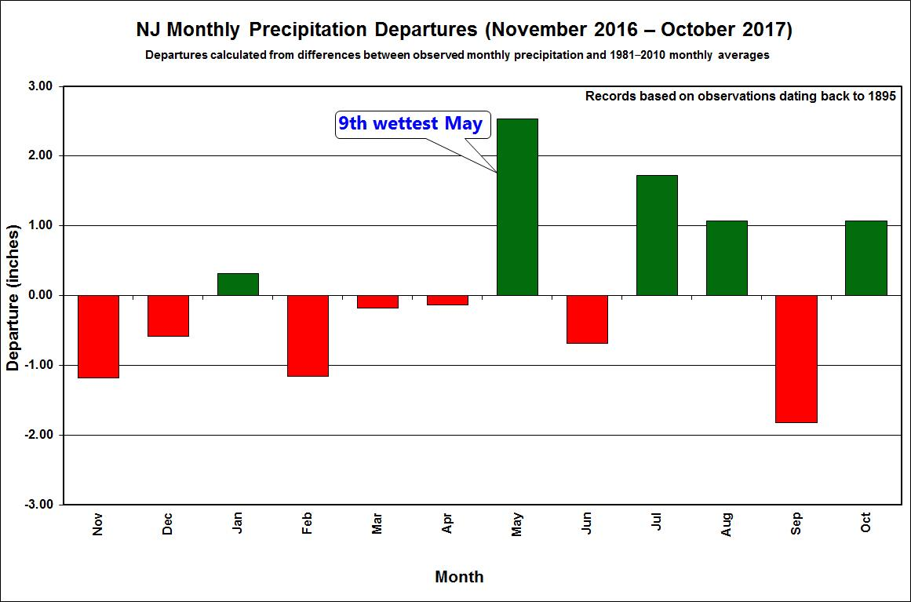
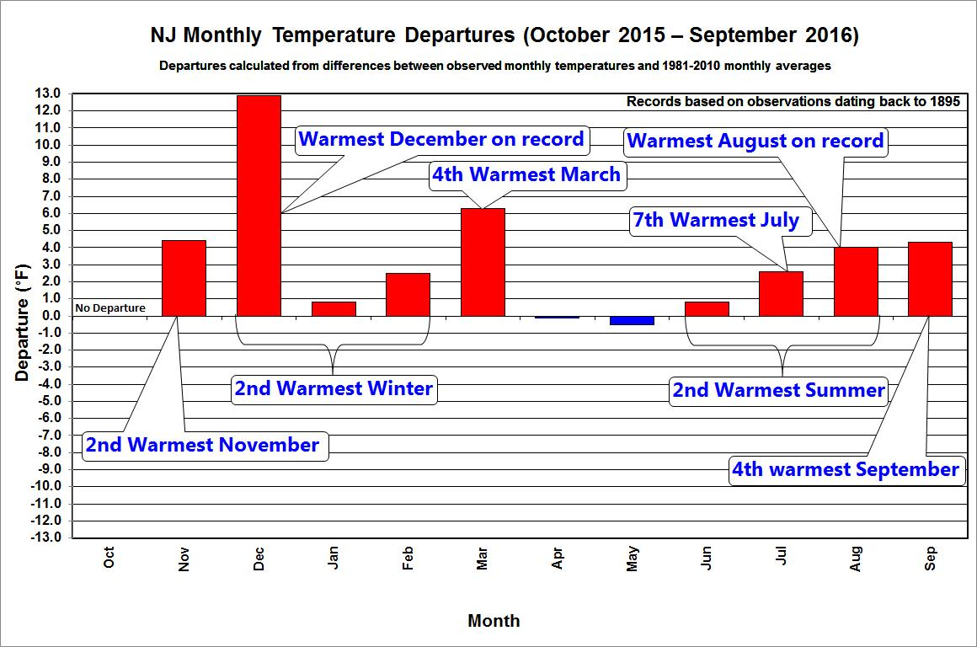
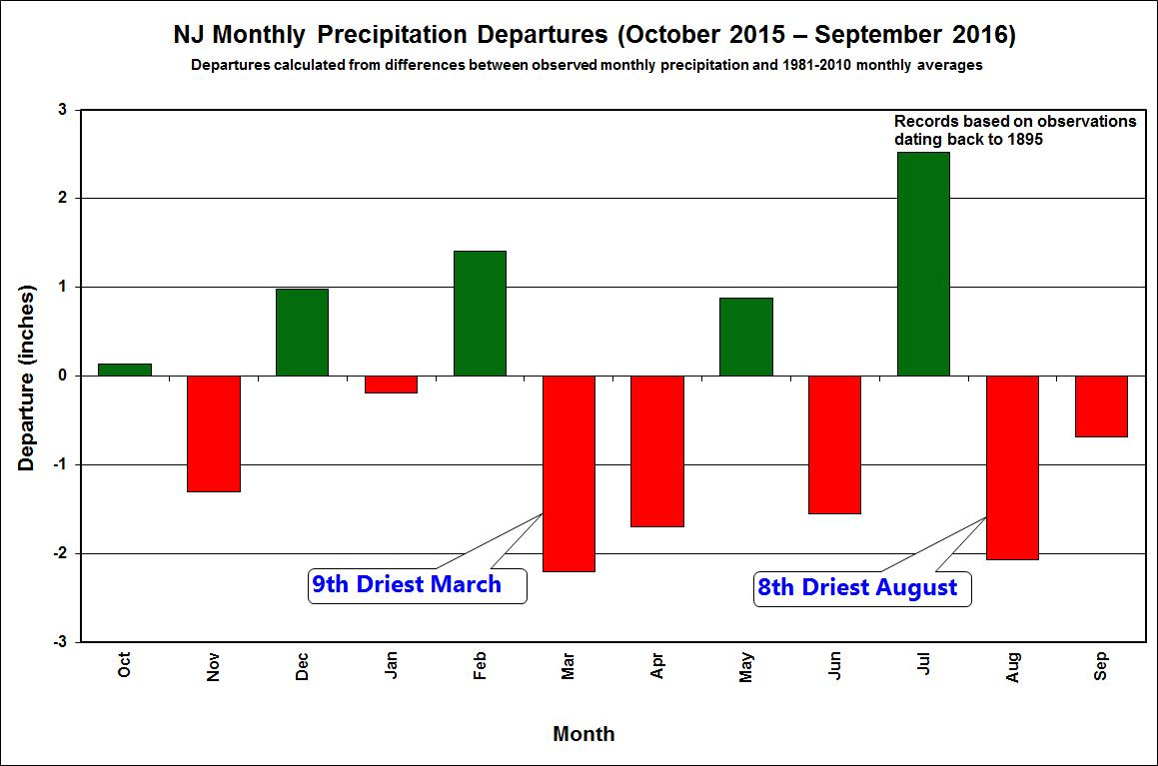
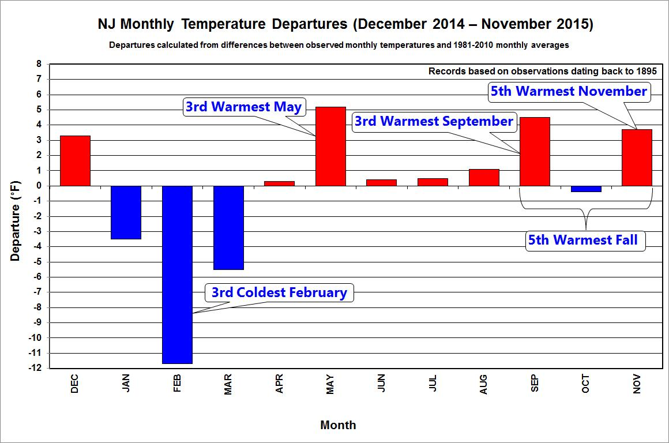
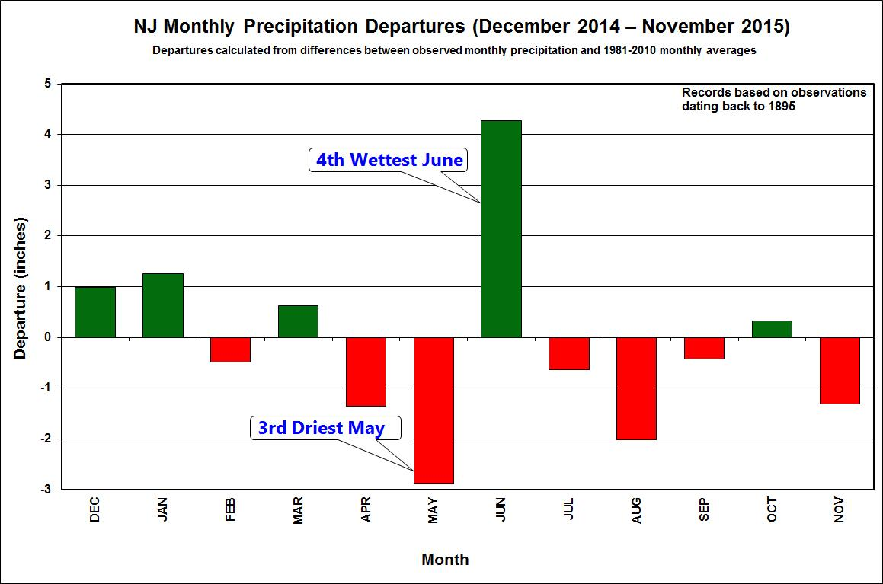
2017
2016
2015

Slide 5
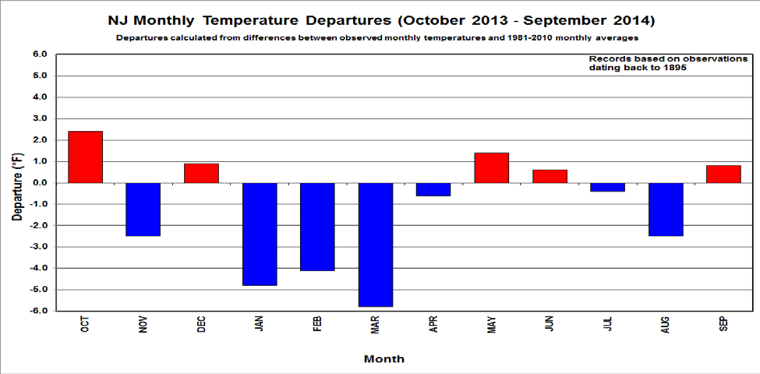
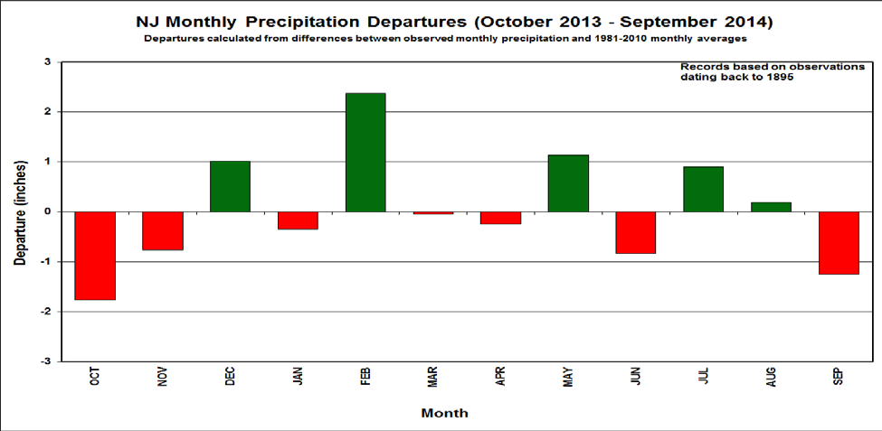
2014
2013
2012

Slide 6
2011
2010

Slide 7
Summary
Year | Temperature |  | Rainfall
 | Spring | Summer | Spring | Summer
2021 | Hot | Hot | Dry | Wet
2020 | Hot | Hot | Normal | Wet
2019 | Hot | Hot | Wet | Normal
2018 | Cold | Hot | Wet | Wet
2017 | Hot | Hot | Wet | Normal
2016 | Normal | Hot | Normal | Dry
2015 | Normal | Hot | Normal | Normal
2014 | Cold | Normal | Wet | Normal
2013
2012
2011
2010

